Slide 1
Woo
- A platform between patients and hospitals
December10th, 2019
Zhaoheng Chen (Product Owner)
Howard Ng
Adam Askari
Vineet Ramareddi
Andrew Hartwell
Scrum Master: All members except Product Owner
Notes:
Jeff

Slide 2
High Level Goals
Woo is a mobile application that builds a platform between patients and hospital, simplifying the tedious process for patients and reducing the workload for medical staff.
Patient Services:
Patient Profiles
Appointment Scheduling/Reminder
Digital Medical-Records
Digital Prescriptions
Medication Reminders/Health Tracking
Staff Services:
Staff Profiles
Appointment Check/Scheduling
Medical-Record Management
Online Prescription System
Notes:
Jeff

Slide 3

Accomplishments
Woo is a mobile application that builds a platform between patients and hospital, simplifying the tedious process for patients and reducing the workload for medical staff.
Patient Services:
Patient Profiles
Appointment Scheduling
Digital Medical-Records
Digital Prescriptions
Staff Services:
Appointment Scheduling
Medical-Record Management
Online Prescription System
Notes:
Jeff

Slide 4
Challenges
Learning React-Native from scratch
Developing UI for both Android and iOS
Asynchronous Javascript
Github merge conflicts
Lack of documentation from APIs
Notes:
Jeff

Slide 5
System Overview
Appointment System
Patient-end
Profile System
React Native
(Supports Android and IOS)
Firebase
Prescription System
Medical-end
Medical Record System
Notes:
Howard

Slide 6
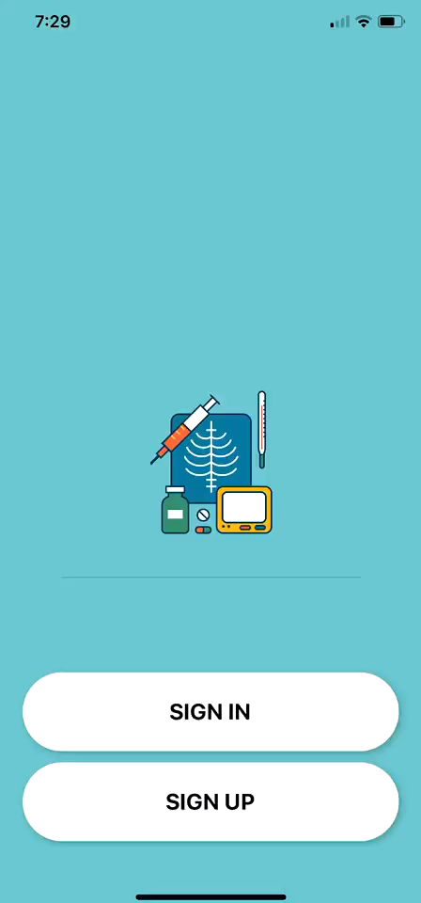
Patient-User overview
YouTube Link
Notes:
Howard

Slide 7
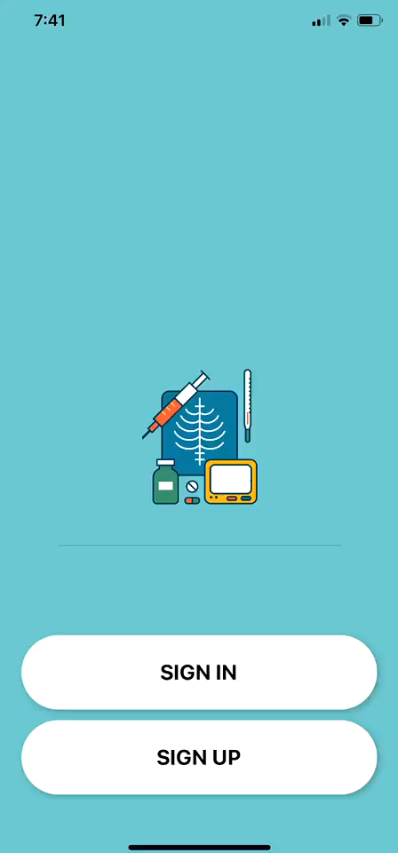
Medical Staff Overview
YouTube Link
Notes:
Howard

Slide 8
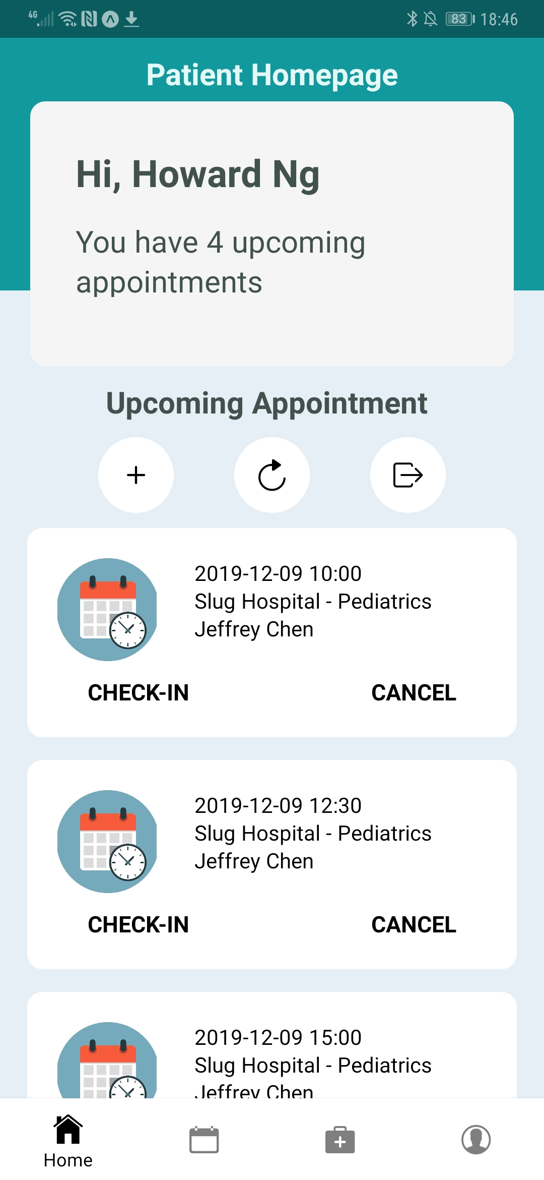
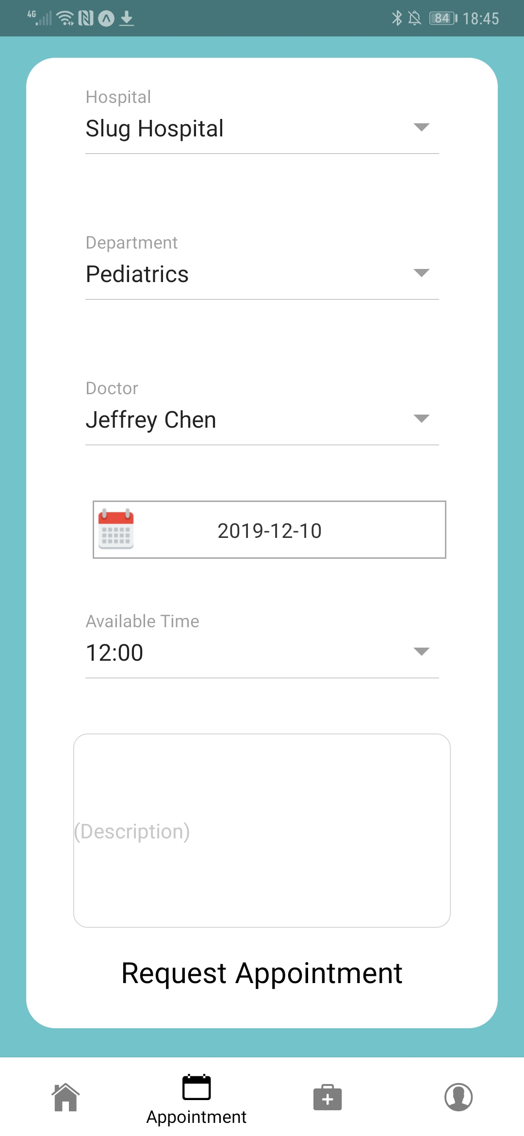
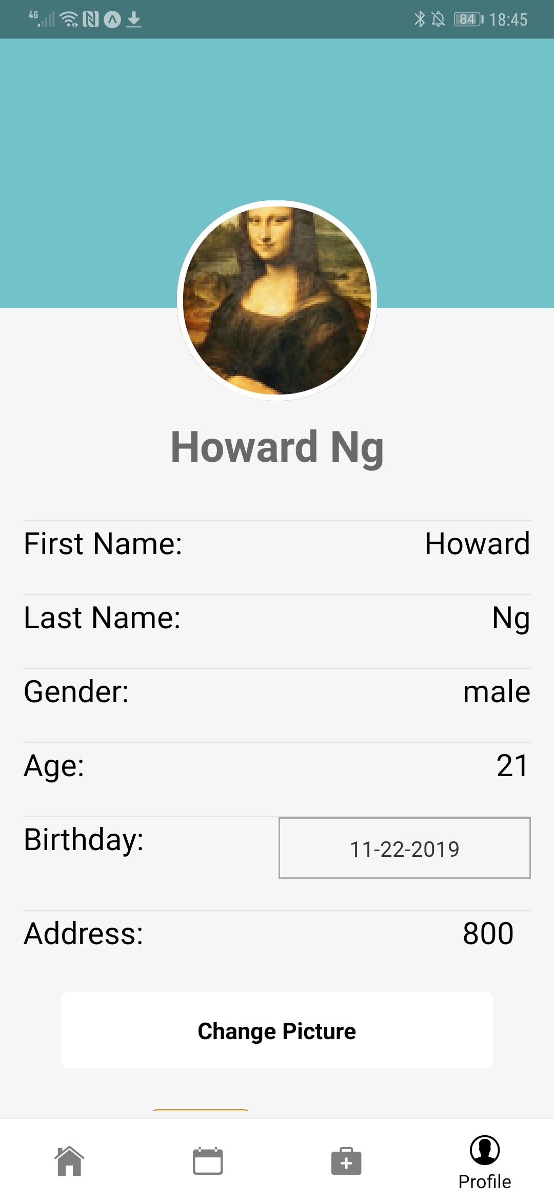
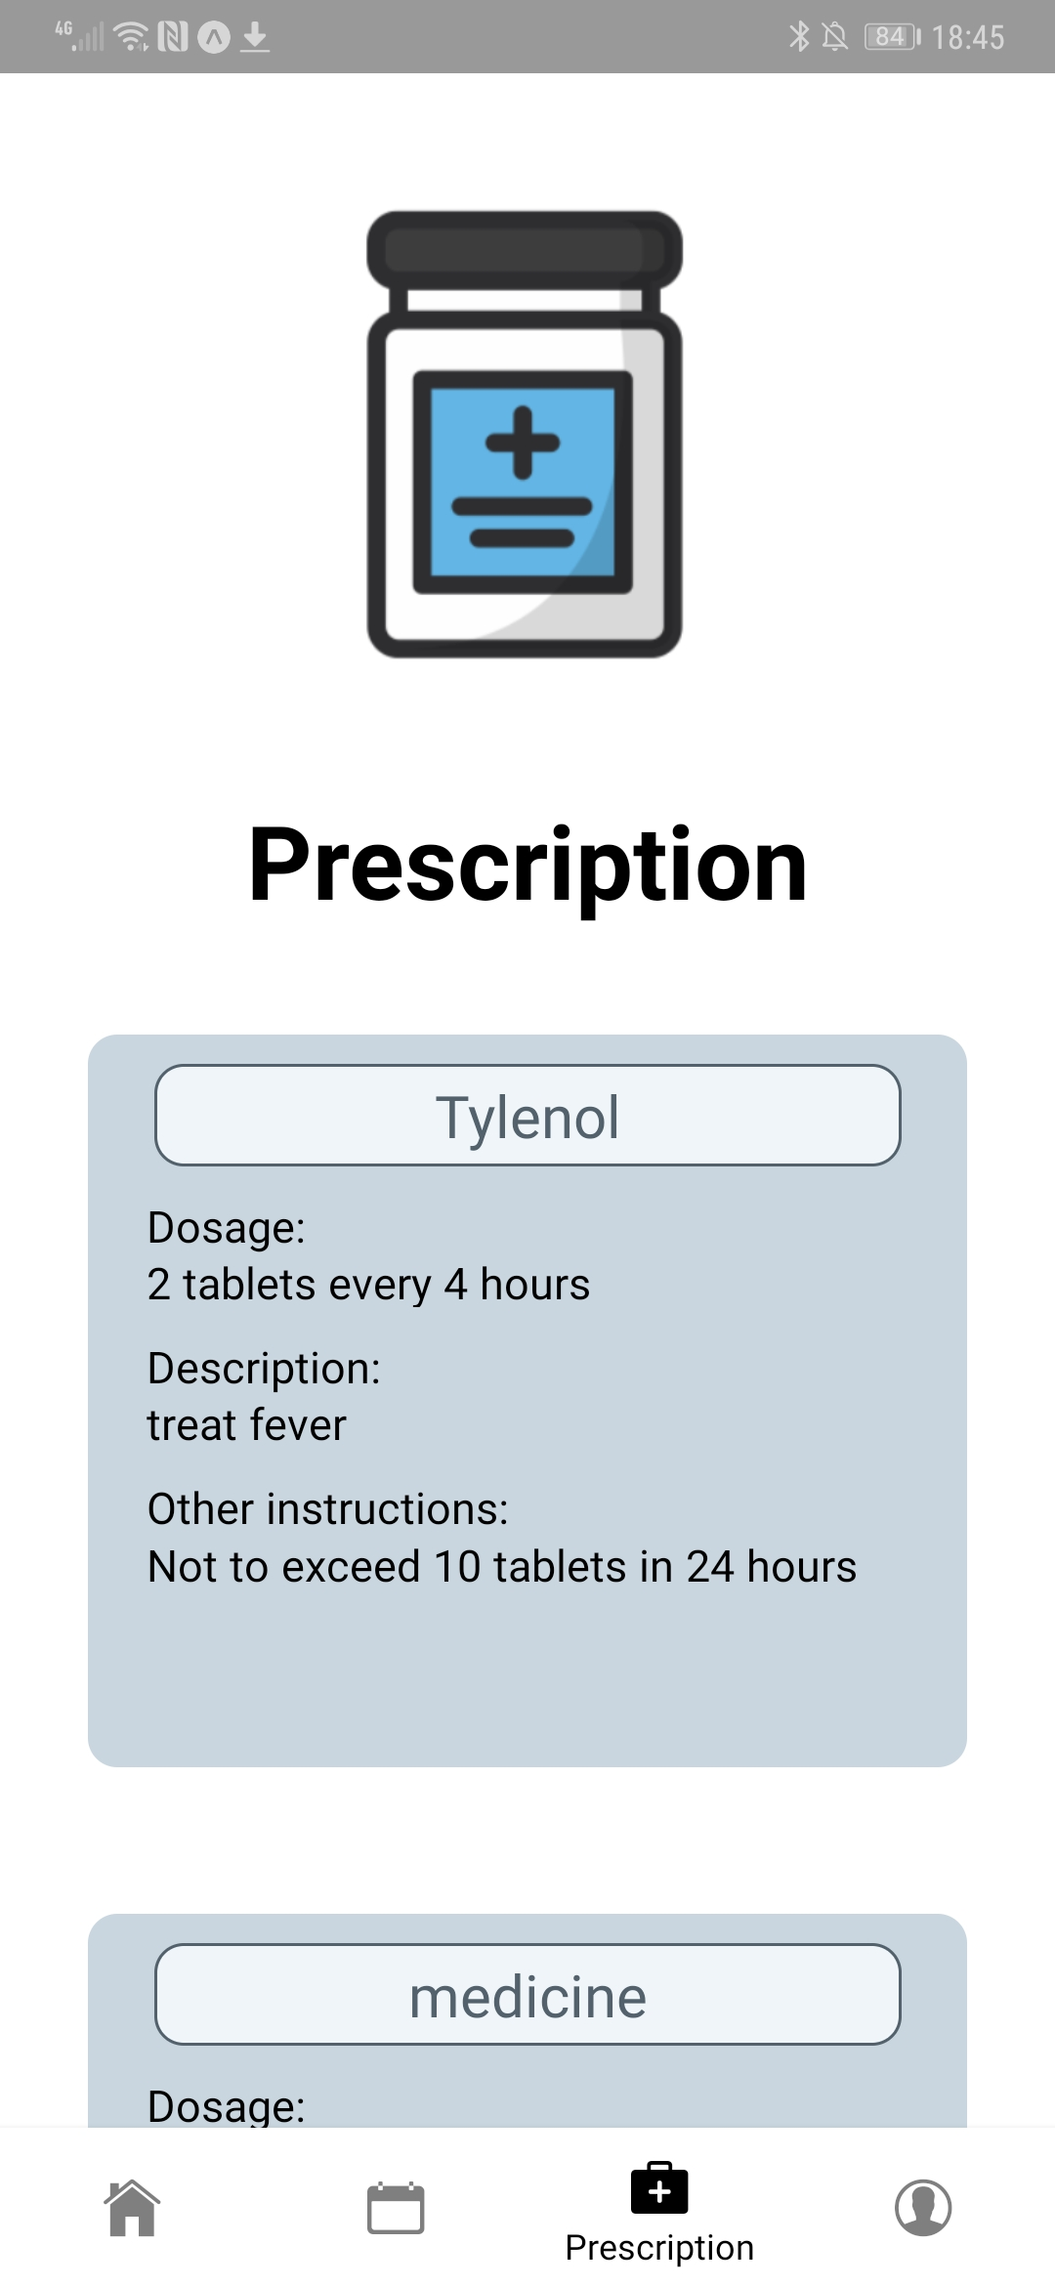
Patient-User Screenshot
Notes:
Howard

Slide 9
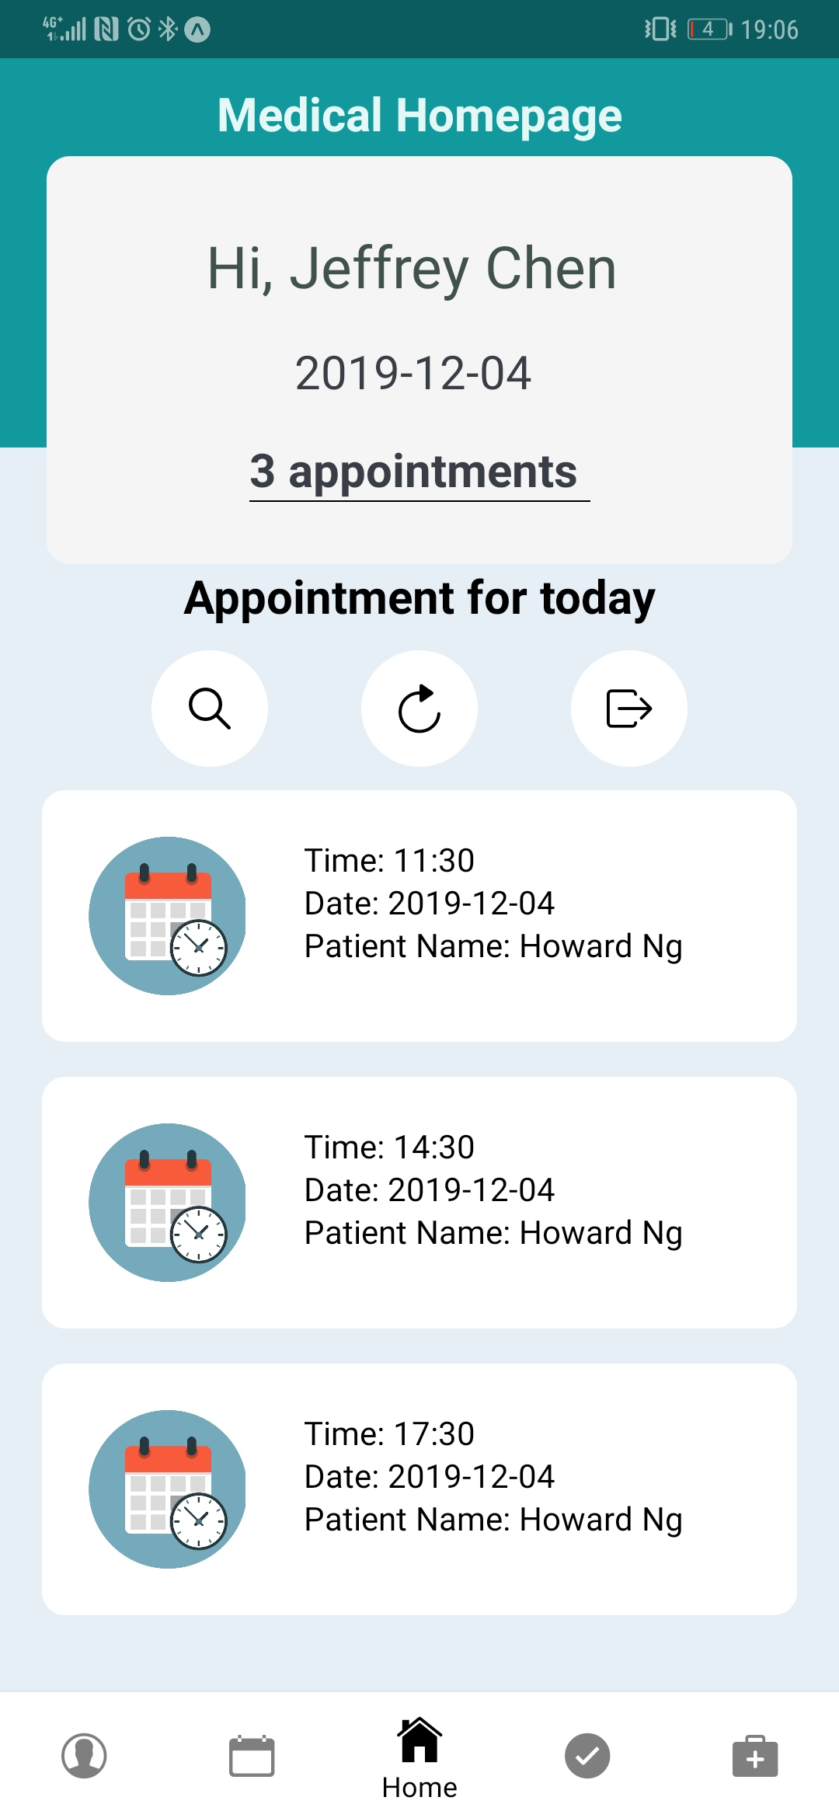
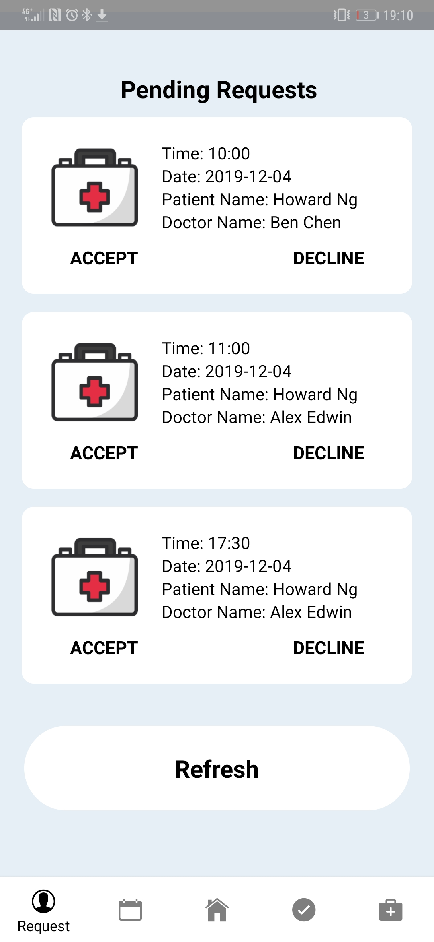
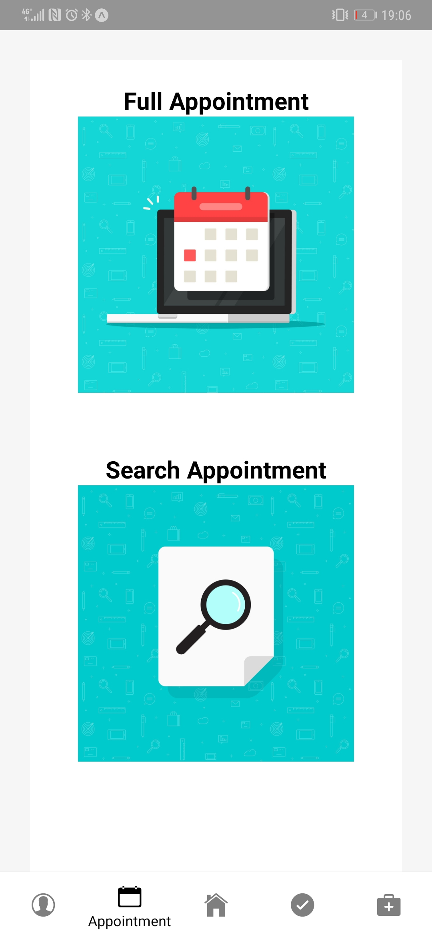
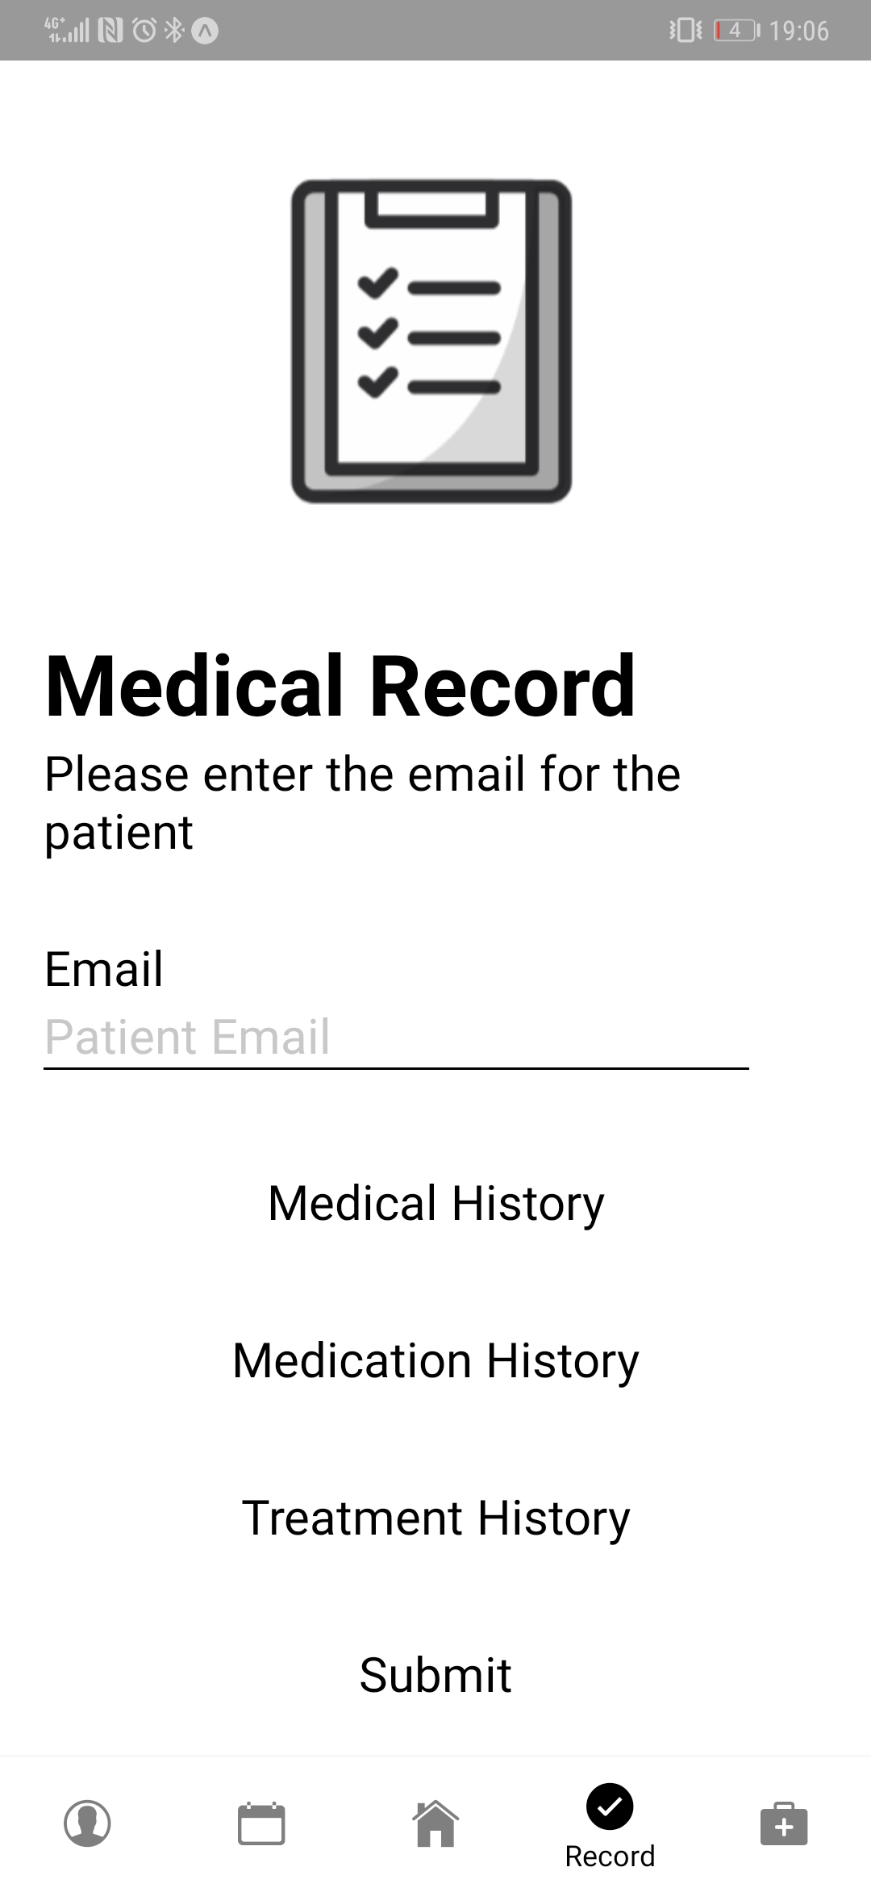
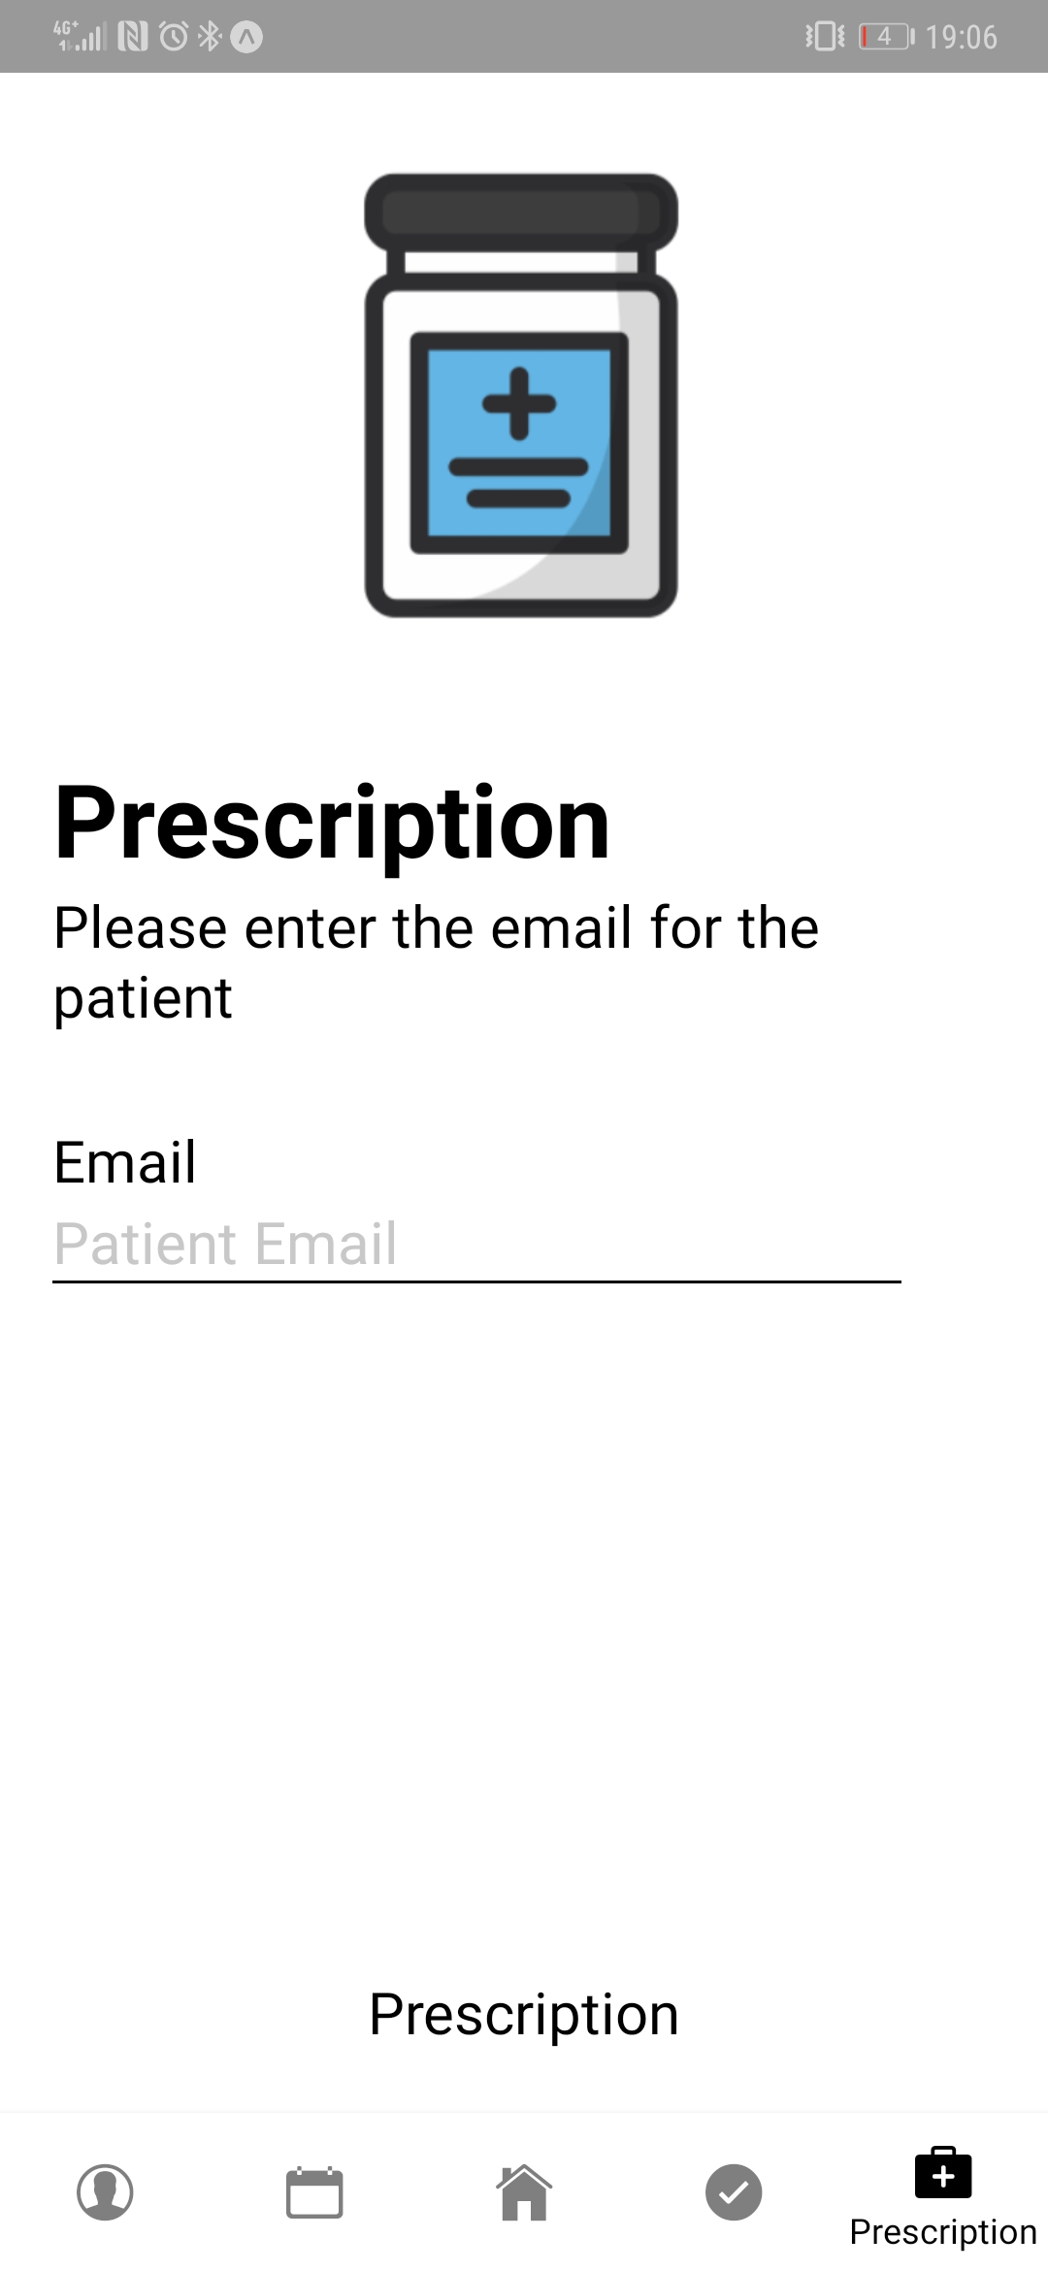
Medical Staff Screenshot
Notes:
Howard

Slide 10




Technologies Implemented
React-Native (Front-end)
Firebase (Back-end)
Jest (Testing)
Expo (Used for running the app)
Notes:
Andrew

Slide 11

Product Management Techniques
Google Drive: Collaborating on Sprint-related documents
Notes:
Andrew

Slide 12
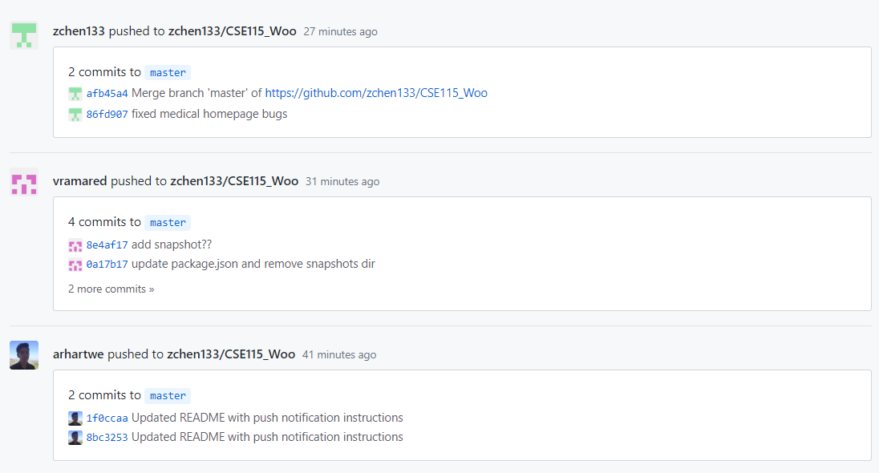
Product Management Techniques
Github: Updating Project
Notes:
Andrew

Slide 13
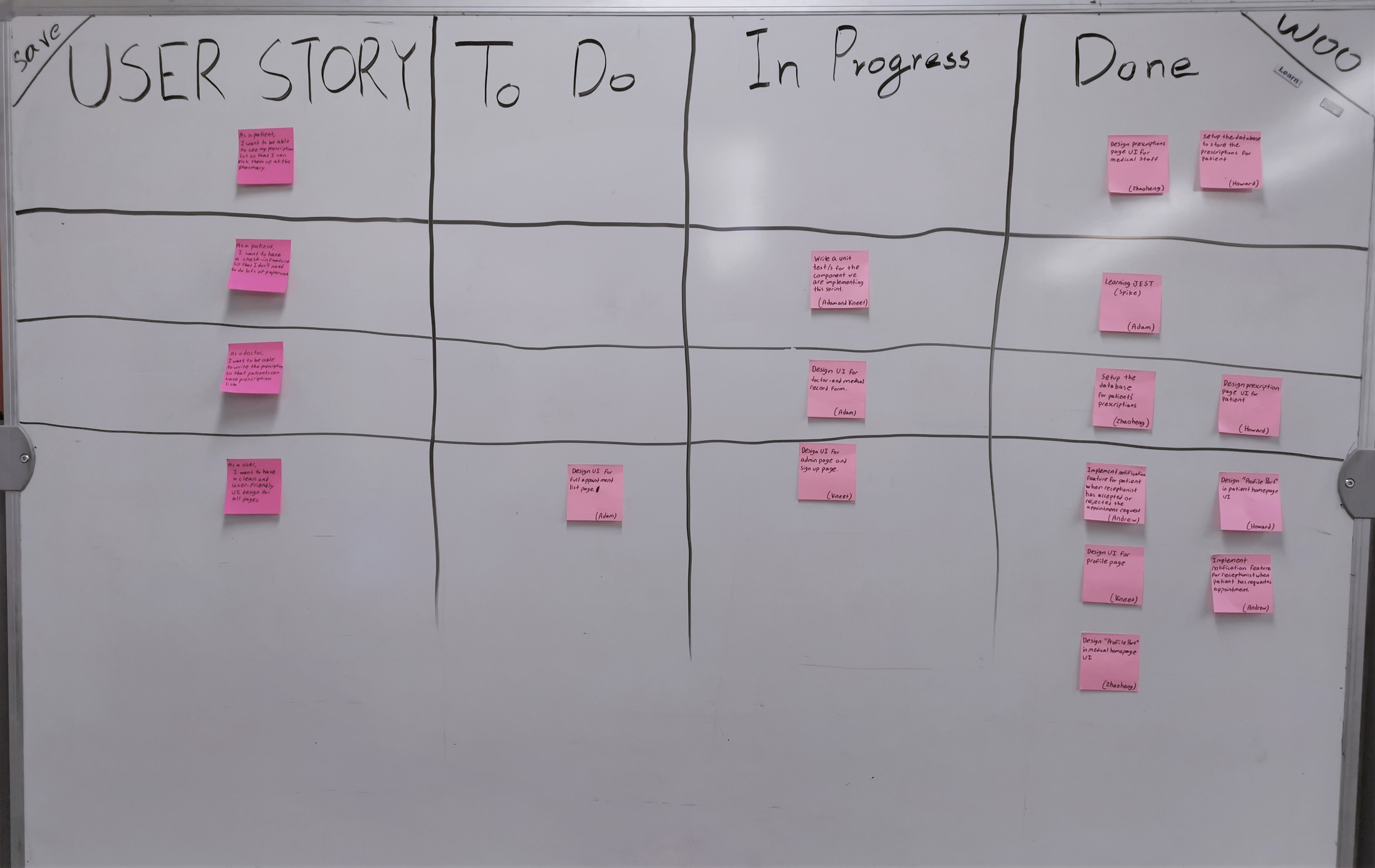
Product Management Techniques
Physical Scrum Board
Notes:
Andrew

Slide 14
Takeaways from Development
Practiced working like software engineers
Balancing UI design and functionality
Learning new APIs weekly
Implementing Agile workflow
Notes:
Vineet

Slide 15
Takeaways from Development
Exercised programming in different modes of development
Backend
Frontend
Integration
Testing
Notes:
Vineet

Slide 16
Takeaways from Development
Self-reflected on
How dependable we are
How we react to challenges
How comfortable we are working with others
Where we stand in terms of skill-level
Notes:
Vineet

Slide 17
Tedious Aspects of Development:
Finding coherent documentation
React-Native: numerous apis→ depreciated styles
Notes:
Vineet

Slide 18
Tedious Aspects of Development:
Integration of frontend and backend
Data displaying correctly
Merging on GitHub
Notes:
Adam

Slide 19
Habits to Continue:
Frequently communicating and holding each other accountable
Documenting as we write code
Utilize some variation of Agile development
Writing unit tests
Notes:
Adam

Slide 20
Habits to Discontinue:
Integrating components at the last minute
Underestimating how long it takes to familiarize oneself with technology.
Notes:
Adam

Slide 21
Our Regrets
Not communicating as much early on
Writing Javascript
Underestimating task work
Notes:
Adam

Slide 22
Thank you for listening
Questions?
Notes:
All

